Slide 1
Where Does Each Student Begin?

Slide 2
Information about _____Jackson___(Jx)_Axshun_______________________
student’s name
To be completed by the Intervention Specialist and/or the Homeroom Teacher:
Homeroom Teacher: _______Mrs. Jones________________________________
Intervention Specialist: ________Ms Smith____________________________
************************************************************************************
Student’s Grade: _2___ Individualized Education Program (IEP)/Title 1/Other ___IEP___
If there is an IEP, what are the student's specific disabilities? _SLD (Specific Learning Disability)_
At what reading level do you suggest we begin? _______1st___________
What are the student's areas of concern in reading?
(mark all that apply)
__ Letter recognition and formation (alphabet) _____________________
__ Sound recognition (phonological awareness)_____________________
_X Phonics _____Skills need more review_______________________________
__ High Frequency Words _____________________________________________
_X Vocabulary _needs to expand and learn definitions/ use in sentences
_X_ Fluency __reading is below grade level, so is fluency
X Comprehension (leveled reading) ____below grade level
How do you think one-to-one mentoring will best help this student??
___Jx needs help at his reading level & at his pace___________________________
What is a realistic goal we can help this student to attain?
__________Think Jx can catch up & read on grade level________________________________
Is there more information that will help the Mentors work with this student?
______Jx enjoys fishing and animals. He wants to read better.­­­­­______________________

Slide 3
How to Determine Which Pack Level*
Use Student’s Fluency Passage Cold Read Score**
(at the Student’s Reading Level)
1st Grade | 20 – 22 | 23 – 25 | 26 – 28 | 29 – 31 | 32 – 34 | 35 – 37 | 38 - 40
 | D | E | F | G | H | I | J

Slide 4
Progress Monitoring: The Coordinator decided to begin at a level lower to build Jx’s confidence, so chose Fluency/Comprehension Level F. The comments by the mentors indicated that Jx read very well, completed the graphic organizer with little help, and did well answering the Comprehension Quick Check. The Coordinator decided to move Jx up to Level G for his second book.
To work on Phonics Review, the Coordinator added Phonics Packs beginning with Lesson 29, Review: VCe long o and long u, Variant vowel /o/ (ball, saw), Variant vowel /oo/ (moon, new, book), Open vowels (me, no)
To work on Vocabulary, the Coordinator put “Added Vocabulary Cards” in Jx’s mentoring folder. The 220 Most Common Words Flash Cards consist of 9 sets and were obtained from: http://www.readinga-z.com/high-frequency-words/most-common-words-flashcards/?level=

Slide 5
Monitoring Student’s Reading Progress
Student Name: ____Jx__Axshun___ _ Date: __9.9.2014_____
Address: ___111 Fifth Street________________
City: ___Rushmore______ State: _OH____ Zip: _40000__
Parent Name: ______Sue Axshun________________
Phone: ________400000_______ Work: ____700000__
Grade: __2___ Home Room Teacher(s): __ Mrs. Jones__ IS: Ms Smith
Birthday: __7.14.2007______
Times and days available for Mentoring: Need 4 sessions of 30 minutes
M __10-10:45__ T _____ W__10-10:45__ TH __10-10:45__ F __10-10:45__
Student’s areas of concern in reading:
__ Letter recognition and formation (alphabet) _____________________
__ Sound recognition (phonological awareness)_____________________
_X Phonics _____Skills need more review_______________________________
__ High Frequency Words _____________________________________________
X Vocabulary _needs to expand and learn definitions/ use in sentences
X_ Fluency __reading is below grade level, so is fluency
X Comprehension (leveled reading) ____below grade level

Slide 6
Timed Oral Reading Fluency Levels (correct words per minute) DIBELS Same Reading Level __1.5___ | How many Mentoring Sessions?
Date:__9.8.14_ Pre: _29_ Errors: _____ Date:__________ Mid: ____ Errors: _____ Date:__________ Post: ____ Errors: _____ | Mid-year ________ End of school year _____
Student’s Readinga-z Category & Pack Level | Readinga-z Fluency Levels Correct words per minute (cold read) on the student’s graphs
______F/G_________________ Initial Instructional Level ____________________________ End of 1st quarter ____________________________ End of 2nd quarter ____________________________ End of 3rd quarter ____________________________ End of 4th quarter | __28___ Initial Level ____F/G_____ _______ End of 1st quarter Level __________ _______ End of 2nd quarter Level __________ _______ End of 3rd quarter Level __________ _______ End of 4th quarter Level __________ _______ Same Level as Initial Level for M4RA Data at end of year.

Slide 7
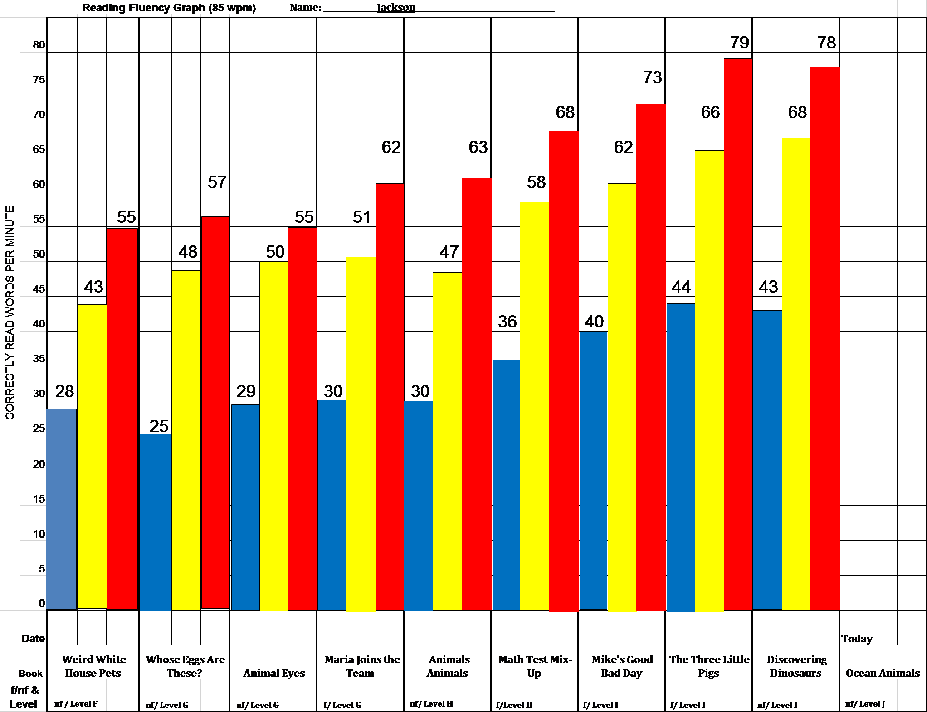

Slide 8
Goals when planning the mentoring sessions:
Complete the Fluency Cold, Warm and Hot timed reads beginning at Level F. May begin at Level B with fluency passages located at www.m4ra.org.
Student has stickers on every page of book or corresponding chart to show he/she knows every word in the book.
Complete the Graphic Organizer(s). Extras may be found at www.readinga-z.com.
All writing activities, including Optional, are completed.
The student learns/learned the skills to find the answers to the Comprehension Quick Checks.

